Slide 1

Analysis of Coronavirus Infections in the United States
Team Mango
Franklin Geeng
Yuxiang Shi
Nikolai Sannikov

Slide 2
Overview
Data that was used
Measure how dangerous each county is via mobility data
Mobility patterns during the nationwide shutdown
Correlation between reduction in mobility and reduction in infection rate
Predictive model for number of infections as a function of mobility, income, and unemployment

Slide 3
Data that Was Used
Dataset Name | Dataset source/creator | Link to Dataset | Country | Temporal range - Start | Temporal range - End | Spatial Resolution
us-counties-4-26.csv | New York Times | https://github.com/nytimes/covid-19-data | United States of America | 1/21/2020 | 4/25/2020 | county
DL-us-mobility-daterow-4-23.csv | Descartes Labs | https://github.com/descarteslabs/DL-COVID-19 | United States of America | 3/1/2020 | 4/23/2020 | county
DL-us-m50_index-4-23.csv | Descartes Labs | https://github.com/descarteslabs/DL-COVID-19 | United States of America | 3/1/2020 | 4/23/2020 | county
Unemployment.csv | US Census Bureau | https://www.ers.usda.gov/webdocs/DataFiles/48747/Unemployment.xls?v=2564.4 | United States of America | 2007 | 2018 | county

Slide 4
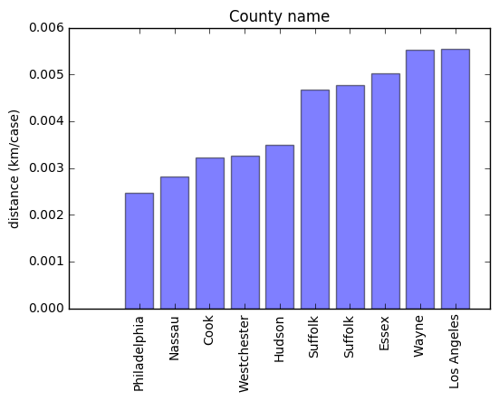
The relationship between accumulative travel distance and confirmed cases
Method: sum up the travel distance people made according to the county and then divide it by the number of confirmed cases, thus we got a constant P for every county.
count 2554.0
mean 50.71
std 248.07
min 0.002478
25% 2.11
50% 10.78
75% 41.61
max 11057.74

Slide 5
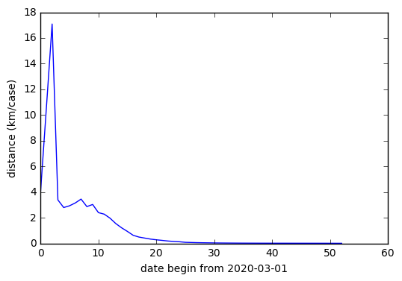
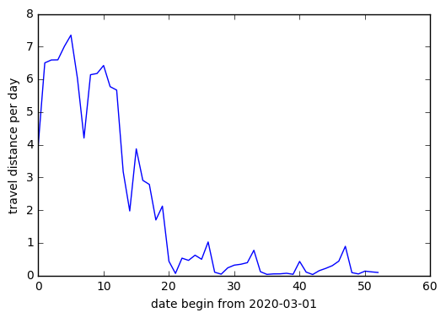
How is the constant P changes in Los Angeles
Why is that even if people travel less than before, the constant P still becomes smaller?
Lack of mobility data from 1/26 to 3/1
Temporary growing travel distance cause the temporary growing P when the number of confirmed cases is still small

Slide 6
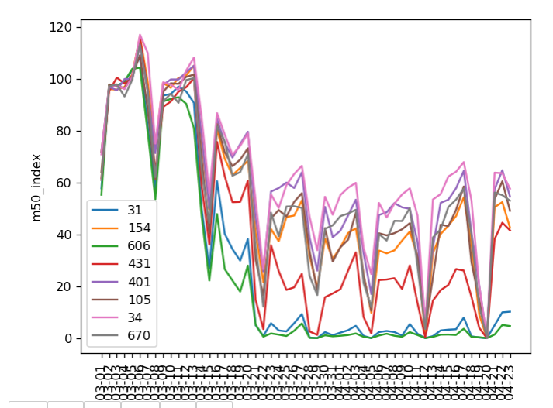
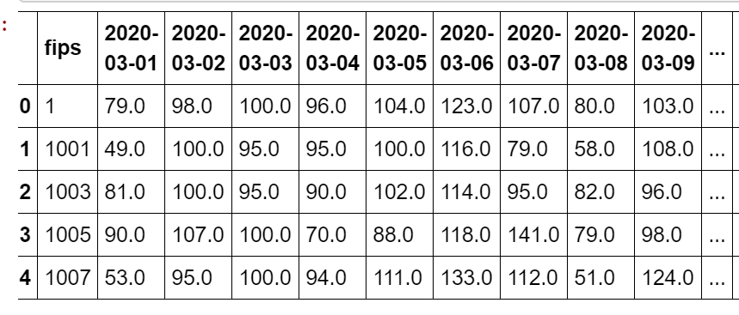
Mobility patterns during nationwide shutdown
Method: K-Means Clustering of daily m50_index
using sklearn.cluster.KMeans
Some identified clusters,
nclusters parameter = 1000
Time series represented as row of daily m50_index. Each daily m50_index is a feature.

Slide 7
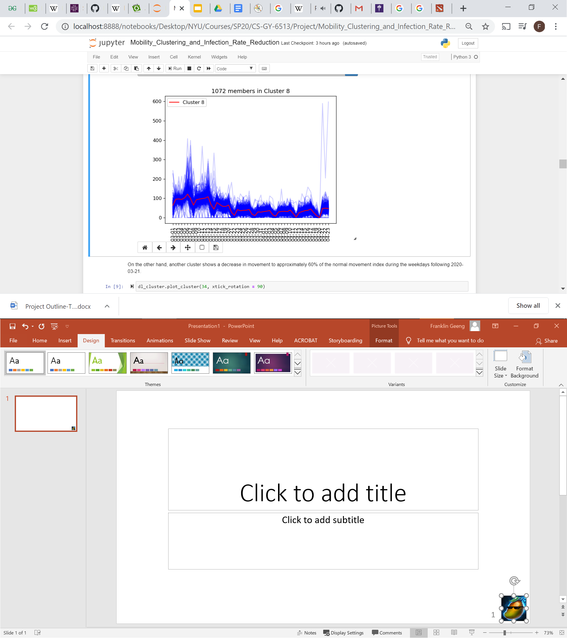
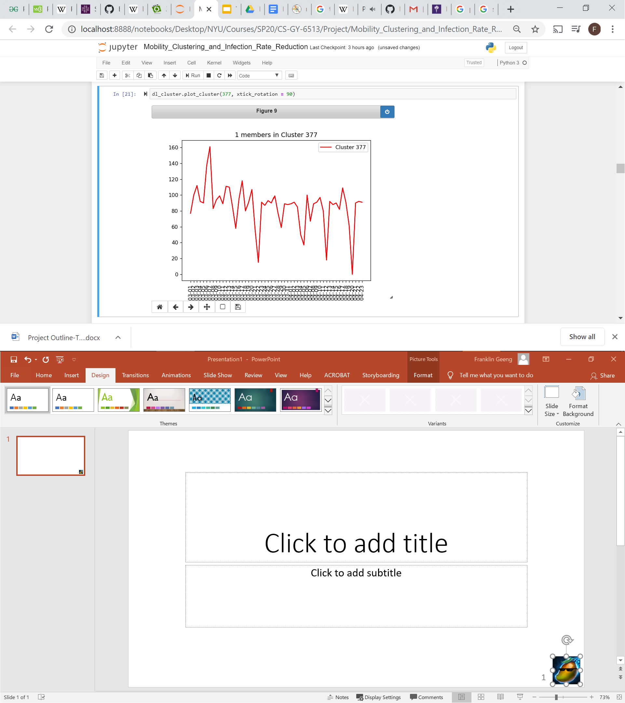
A wise man on Stack Overflow once said: ‘...write a function for any piece of code you run more than once…’: implemented reusable functions and class for visualization
Actually use clustering to identify outliers (classes with only one member)
Either significant increase in mobility prior to lockdown or a monthly pattern in mobility not accounted for by normalization
Very little reduction in mobility

Slide 8
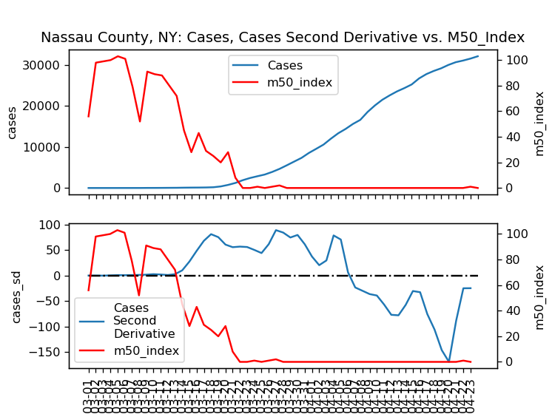
Correlation Between Mobility and Infection Rate
-Interested in whether infection rate decreases when mobility decreases
-Second derivative of infection counts is change in infection rate
(negative means number of new cases is decreasing)

Slide 9
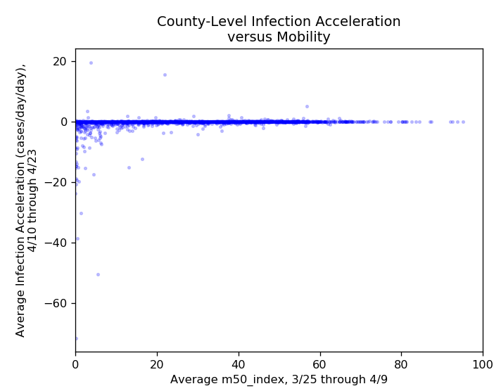
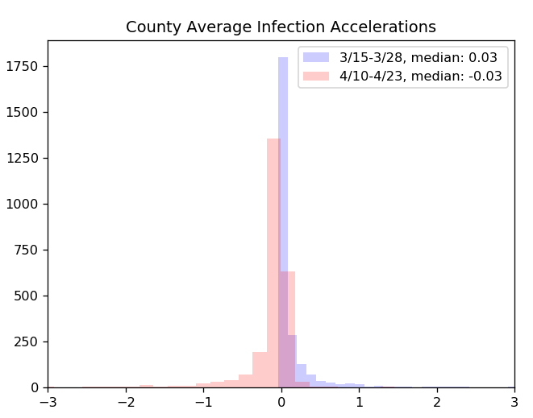
Reduction in infection rates following reduction in mobility
One the whole, outbreaks are decelerating
Still some accelerating outbreaks
Many negative average changes in infection rate, some very large

Slide 10
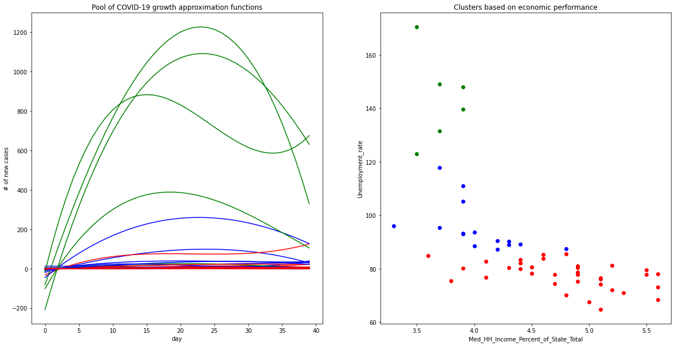
COVID-19 Spread Patterns Determined By Socio-Economic Standing
NY state data used to illustrate approach
If the counties are similar in their economic and social background do they have similar COVID-19 spread patterns?
How to measure socio-economic standing?
Unemployment
Median Household Income
Percentage of median household income of a state
To find similar counties use K-means clustering => trivial

Slide 11
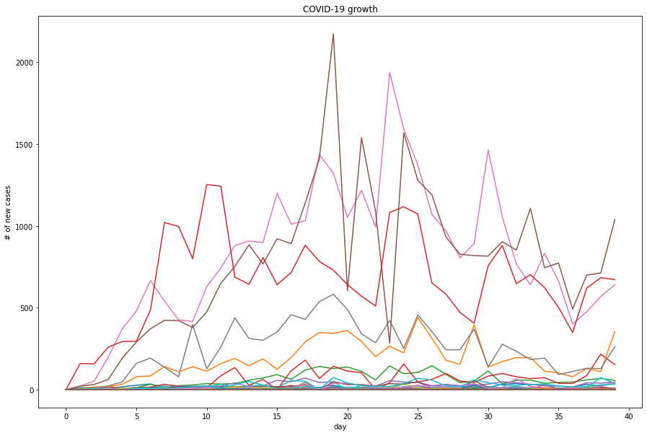
COVID-19 Spread Patterns
NY state data used to illustrate approach
Finding pattern of COVID-19 spread not so trivial:
data is noisy
How to find average pattern for a cluster?
Taking average for each day?
Extremely noisy => big picture is lost
SOLUTION: Use polynomial approximation
Noise is reduced, but big picture is saved
For cluster can take average of a few parameters

Slide 12
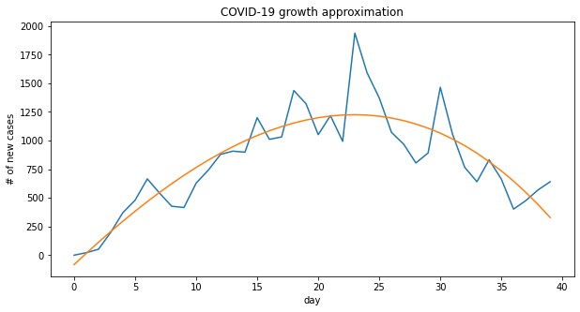
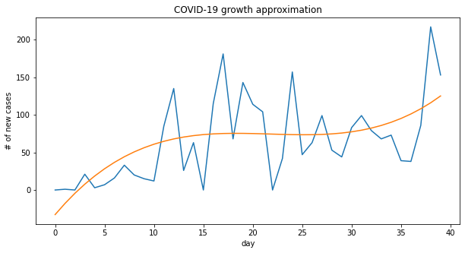
Making polynomial approximation
SOLUTION: Use polynomial approximation
Noise is reduced, but big picture is saved
For cluster can take average of a few parameters
Need to find balance:
Complex enough to reflect major trends
Simpler is better
Polynomial of a degree 3 looks good enough
Just 4 parameters [w0, w1, w2, w3]
f(x) = w3*x^3+ w2*x^2 + w1*x + w0
x - day number
f(x) - number of new cases

Slide 13
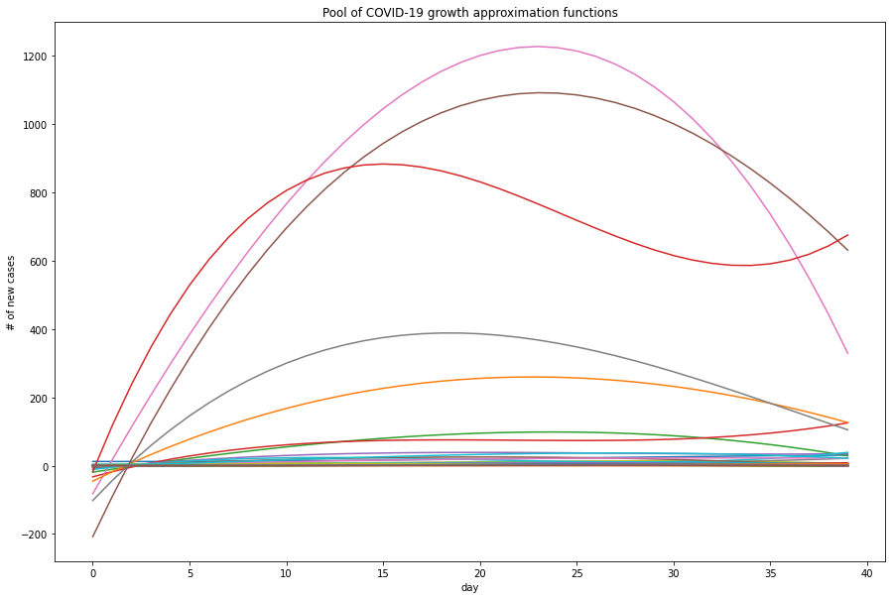
Pool of polynomial approximations
NY state data used to illustrate approach
Noise is reduced, but big picture is saved

Slide 14
Time to cluster
NY state data used to illustrate approach
Counties from different clusters seem to have different spread patterns
Rich counties
Poor counties

Slide 15
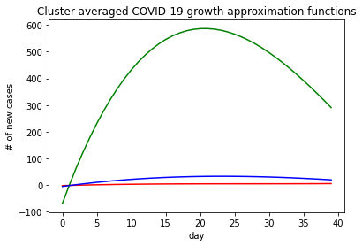
Cluster-based Average Models
Counties from different clusters have different spread patterns
For cluster can take average of just 4 polynomial parameters
If there was no difference => socio-economic standing does not really matter
But the models are quite different
Explosive growth for rich counties
But do the average models still reflect the real data?

Slide 16
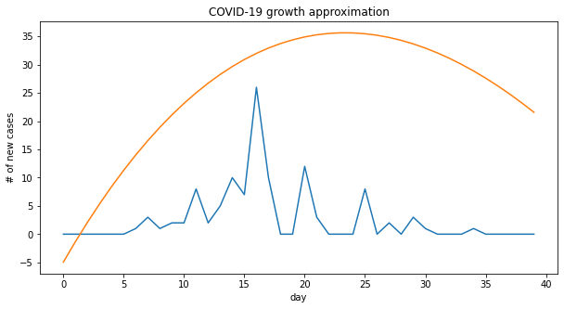
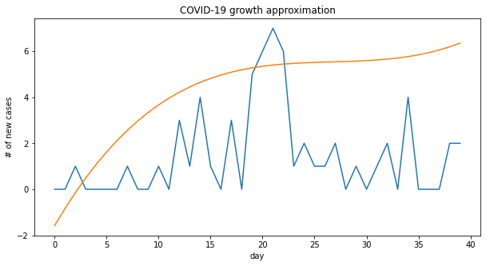
Cluster-based Average Models
But do the average models still reflect the real data?
Are these models applicable to counties we have never seen before?
Exclude some counties from computing average models Compare the model of a corresponding cluster to the real recorded data
Looks reasonable enough => averaged models work for counties we have never seen yet, but saw many similar ones

Slide 17
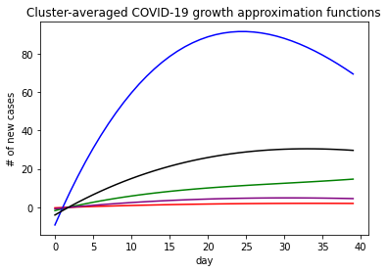
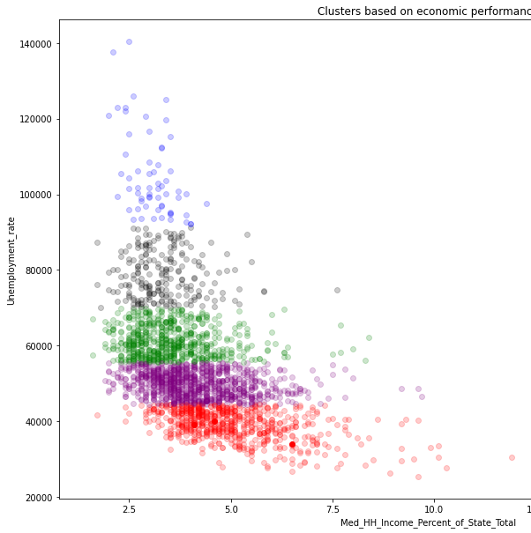
Now, for the whole country
Clusters have different average patterns
More counties => more clusters
Now k=5
Different economic groups have different patterns
Rich counties suffer more
Therefore, socio-economic factors are important

